Slide 1


01
The Future of Human Machine Interface
What's in store for us?

Slide 2
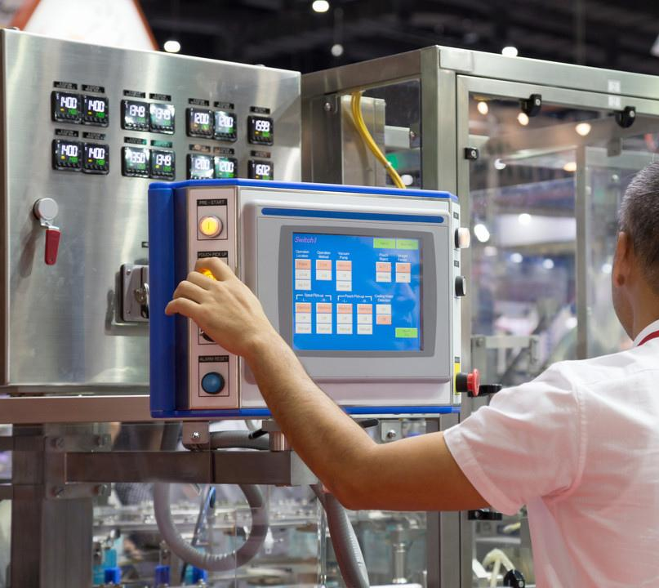
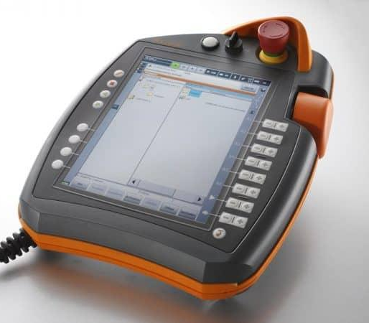
02
HMI
is an important part of applications.

Slide 3



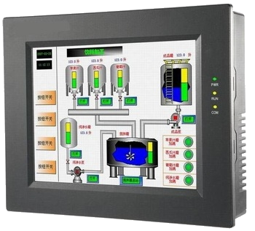
03
But you can't expect things to stay the same.
Limitations of Traditional HMI - Lack of screen space.
Cramped UI.
Lack of information .
Limited or No Portability.
Expensive. Cumbersome.
Outdated looks.

Slide 4


04
HOW CAN WE MAKE THINGS BETTER?

Slide 5
RISE OF
AUGMENTED REALITY
06
Presentations are communication tools that can be used as demonstrations, lectures, speeches, reports, and more.
It is mostly presented before an audience.
Presentations are communication tools
that can be used as demonstrations,
lectures, speeches, reports, and more.
It is mostly presented before an audience.
Presentations are communication tools
that can be used as demonstrations,
lectures, speeches, reports, and more.
It is mostly presented before an audience.

Slide 6
RISE OF
AUGMENTED REALITY
07
Presentations are communication tools that can be used as demonstrations, lectures, speeches, reports, and more.
It is mostly presented before an audience.
Presentations are communication tools
that can be used as demonstrations,
lectures, speeches, reports, and more.
It is mostly presented before an audience.
Presentations are communication tools
that can be used as demonstrations,
lectures, speeches, reports, and more.
It is mostly presented before an audience.

Slide 7
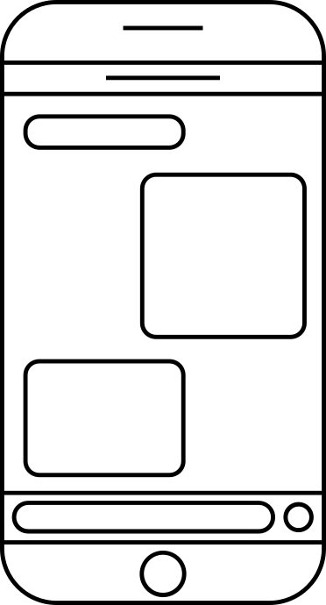

BRAIN-COMPUTER INTERFACE
08
Presentations are communication tools that can be
used as demonstrations, lectures, speeches, reports,
and more. It is mostly presented before an audience.
Presentations are communication tools that can be used
as demonstrations, lectures, speeches, reports, and more.
It is mostly presented before an audience.

Slide 8


ELECTRONIC PAPER
Presentations are communication tools that can be
used as demonstrations, lectures, speeches, reports,
and more. It is mostly presented before an audience.
Presentations are communication tools that can be used
as demonstrations, lectures, speeches, reports, and more.
It is mostly presented before an audience.

Slide 9

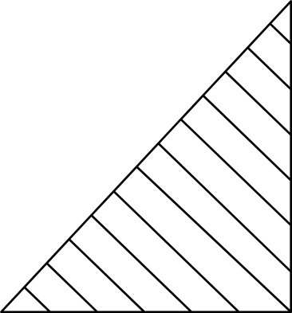
Presentations are communication tools that can be used as demonstrations, lectures, speeches, reports, and more. It is mostly presented before an audience. It serves a variety of purposes, making presentations powerful tools for convincing and teaching.
WHOLE BRAIN EMULATION
Presentations are communication tools that can be used as demonstrations, lectures, speeches, reports, and more. It is mostly presented before an audience.

Slide 10


11
AUTO TRANSLATION
Presentations are communication tools that can be used as demonstrations, lectures, speeches, reports, and more.
It is mostly presented before an audience.

Slide 11
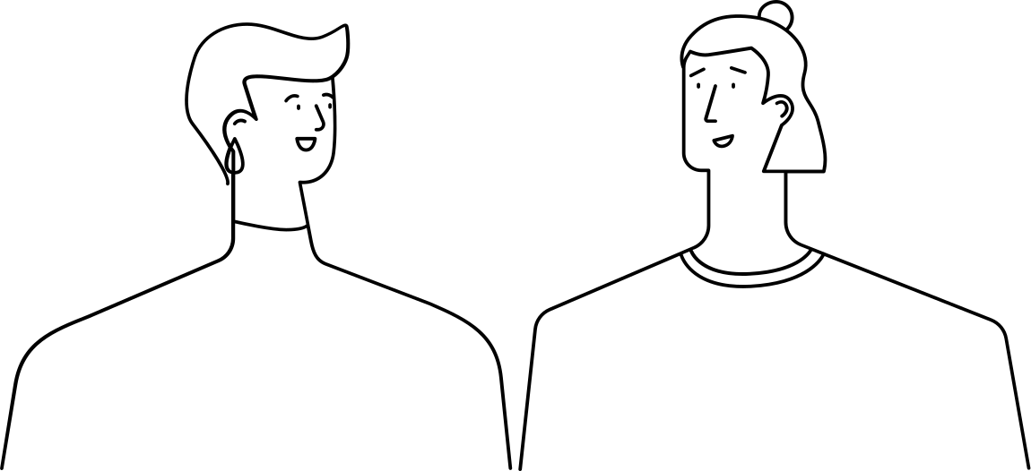
PROLIFERATION OF CHAT BOTS
Presentations are communication tools that can be used as demonstrations, lectures, speeches, reports, and more.
It is mostly presented before an audience.

Slide 12


13
DIGITAL TELEPATHY
Presentations are communication tools that can be used as demonstrations, lectures, speeches, reports, and more.
It is mostly presented before an audience.
Presentations are communication tools that can be used as demonstrations, lectures, speeches, reports, and more.
It is mostly presented before an audience.

Slide 13
14
Presentations are communication tools that can be used as demonstrations, lectures, speeches, reports, and more. It is mostly presented before an audience. It serves a variety of purposes, making presentations powerful tools for convincing and teaching.
AN ERA
OF VIDEO CONFERENCING
Presentations are tools that can be used as demonstrations, lectures, speeches, reports, and more. It is mostly presented before an audience.

Slide 14
Electric communication
will never be a substitute for
the face of someone who with their soul encourages another person to be brave and true.
Charles Dickens

